Slide 1
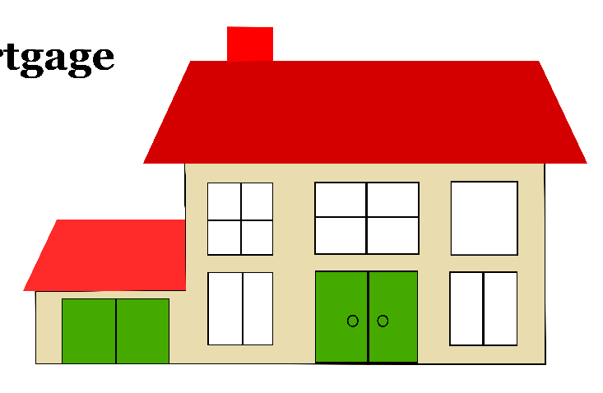

Predicting Mortgage Loan Repayment Ability: A ML Classification Project
Prakash Parajuli, PhD
Data Science Capstone Project, 2021
Mortgage Loan Process….
Thanks to Springboard Mentor:
Ajith Kumar

Slide 2
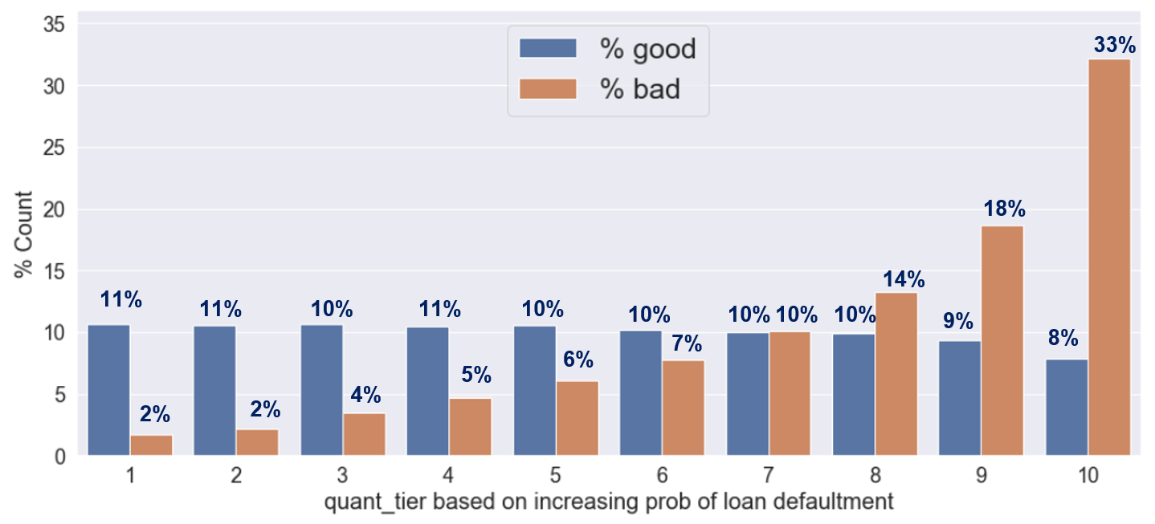
Project Overview
Problem:
What major factors determine the mortgage loan repayment ability? Can we predict the client’s repayment abilities by employing the various features of the client’s rather than solely depend on credit histories?
Datasets
Application, Bureau, Bureau Balance, Credit Card Balance, Installments Payments, Pos_cash_balances, Previous application
Business Strategy
Data Wrangling, EDA (inferential statistics), Feature engineering,
and Preprocessing
Supervised Classification Algorithms /Evaluation (ROC_AUC)/ Hyperparameter tuning
Applicants lying on the last tier can be completely declined and on second tier can be handled manually and all others can be blindly approved.

Slide 3
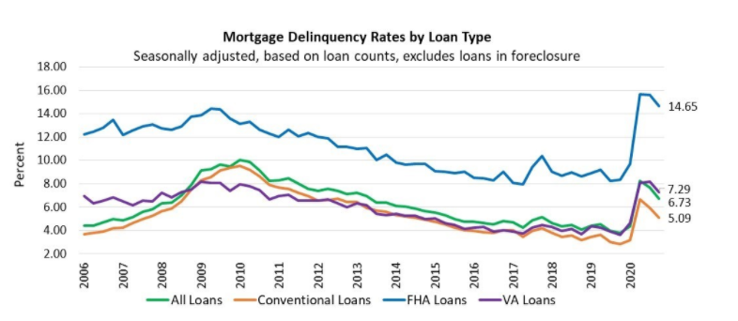


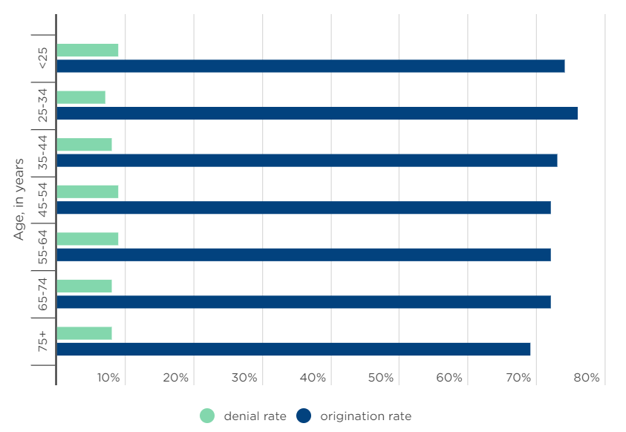
The Problem
Mortgage loan delinquency rate is generally higher and is rapidly increasing after 2020 pandemic?
In general, the mortgage application denial rate approx. 8%
What major factors determine the mortgage loan repayment ability?
Can we predict the client’s repayment abilities by employing the various features of the client’s such as: employment, financial status, family status, education and many more rather than solely depend on credit histories?

Slide 4

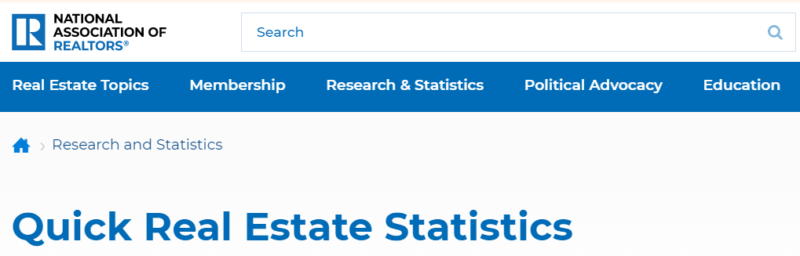

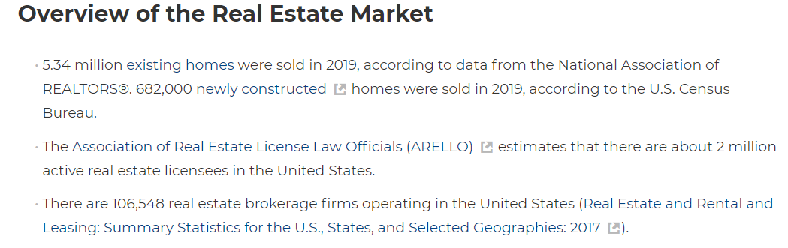


Who might be benefitted?
Mortgage Loan Lenders
Realters and consumers

Slide 5
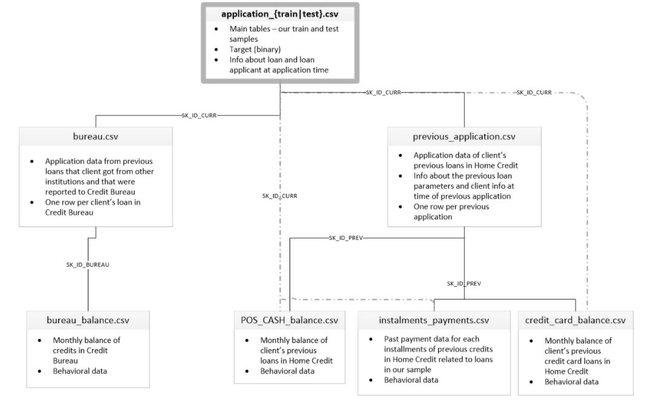
Data Extraction:
What factors might affect the loan repayment ability beyond credit history?
Demographic:
Age, sex, education, family status, neighborhood etc.
Financial :
Employment, Debts, investments, credit inquiries etc.
Home credit Dataset (Kaggle.com)

Slide 6
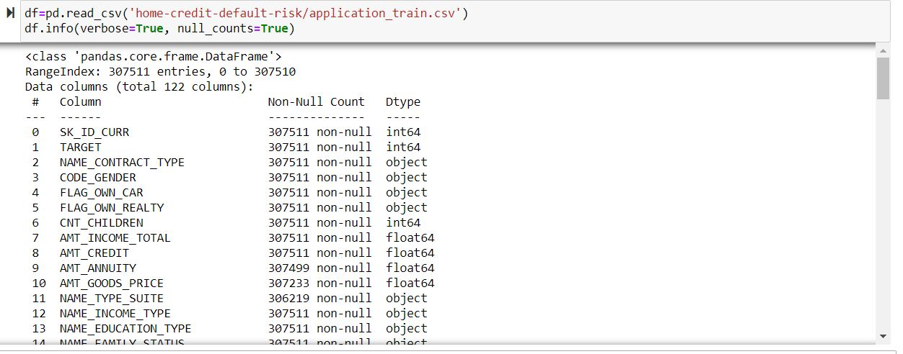
Data Exploration:
Primary Data: Application
Additional Data:
There are additional 6 datasets representing secondary information of the applicants; bureau, bureau balance, previous loan and credit activities.
Similar to the Application train datasets there are numerous missing values and features are skewed.
There is total 307,511 rows representing the information of each loans and 120 features.
The response variable: TARGET defines if the client had payment difficulties, 1 representing the client had at least one late payment (loan defaulted) and 0 as loan repaid.
Many features contain null values, 40 features have more than 50% missing values

Slide 7
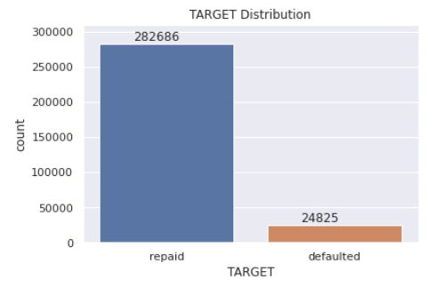
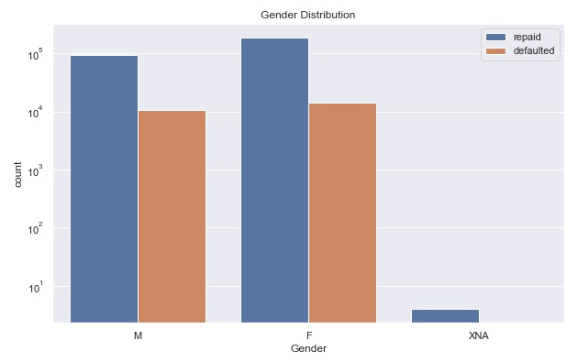
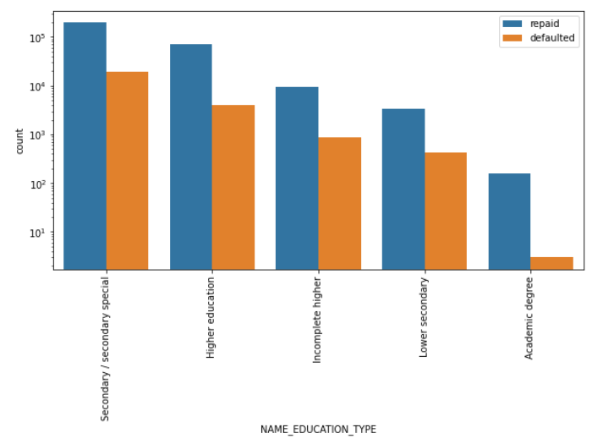
EDA: Application Dataset
Does gender affect loan repayment ability?
Class imbalance
Not significantly.
Does Education degree affect loan repayment ability?
Yes, Applicant with academic degree have a greater chance to repay loan.

Slide 8
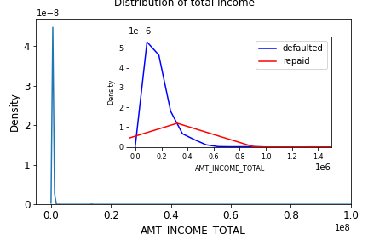
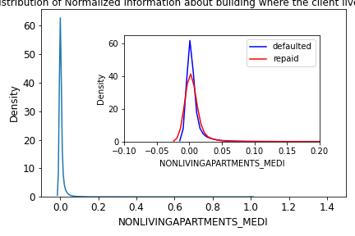
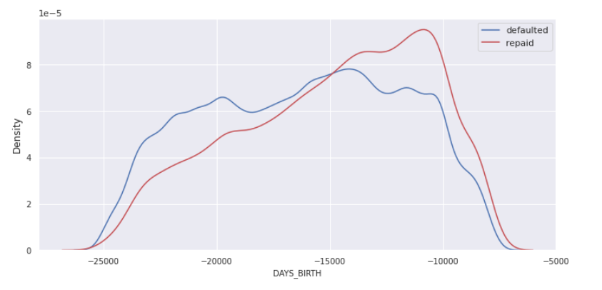
EDA: Application Dataset
Does income of a client affect loan repayment ability?
Does info of the building residing by applicant affect loan repayment ability?
Not significantly.
Yes, lower income applicant has greater chance of loan default.
Does age of the by applicant affect loan repayment ability?
Not significantly.

Slide 9

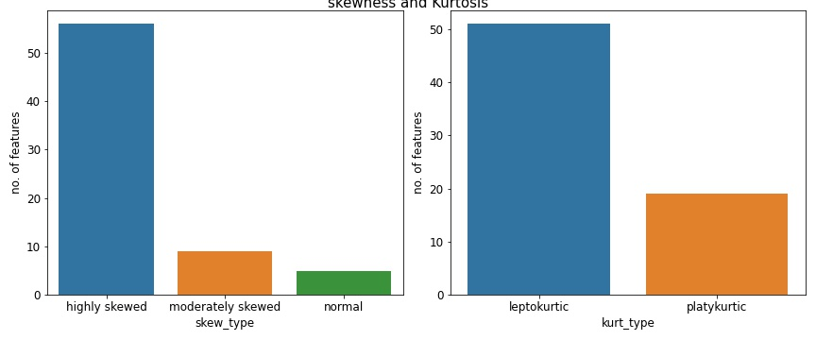
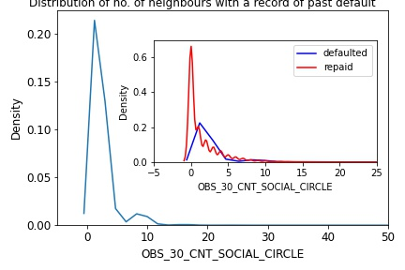
EDA: Application Dataset
Skewness and Kurtosis
Top highly skewed and peaked features
Skewness | Skew_type
<=-1 and >=1 | Highly Skewed
>-1 and <-0.5 <=1 and >0.5 | Moderately Skewed
<=0.5 and >=0.5 | Normal
Kurtosis | Kurt_type
=3 | Normal
>3 | Leptokurtic
<3 | Platykurtic

Slide 10
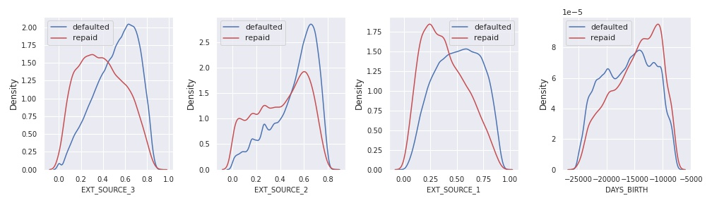
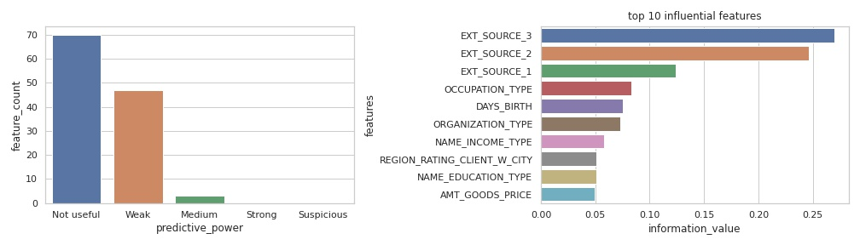
EDA: Application Dataset
Weight of Evidence/Information Value of the features
Information Value | Variable Predictiveness
Less than 0.02 | Not useful for prediction
0.02 to 0.1 | Weak predictive Power
0.1 to 0.3 | Medium predictive Power
0.3 to 0.5 | Strong predictive Power
>0.5 | Suspicious Predictive Power
Features: External_source_1 and External_source_3 shows a highly distinct distribution for two classes. These features might be suspicious and needs attention during modelling.

Slide 11
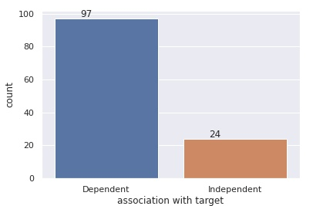
EDA: Application Dataset
Chi Square Test
Chi-square test and Information value are in agreement showing features with medium/weak predicting power shows chi square association with Target.

Slide 12
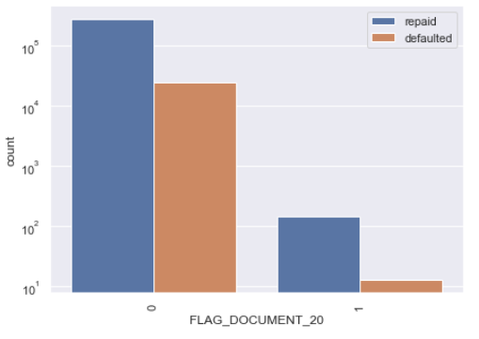
Chi Square Test
Does gender affect loan repayment ability?
Does Education degree affect loan repayment ability?
Not significantly.
Yes, Applicant with academic degree have a greater chance to repay loan.
P-value: 2.447681e-219, Rejected Null hypothesis
P-value: 9.780256e-01, Accepted Null hypothesis

Slide 13
Chi Square Test
Does income of a client affect loan repayment ability?
Does info of the building residing by applicant affect loan repayment ability?
Not significantly.
Yes, lower income applicant has greater chance of loan default.
P-value: 0.02004, Accepted Null hypothesis
P-value: 7.022957e-45, Rejected Null hypothesis

Slide 14
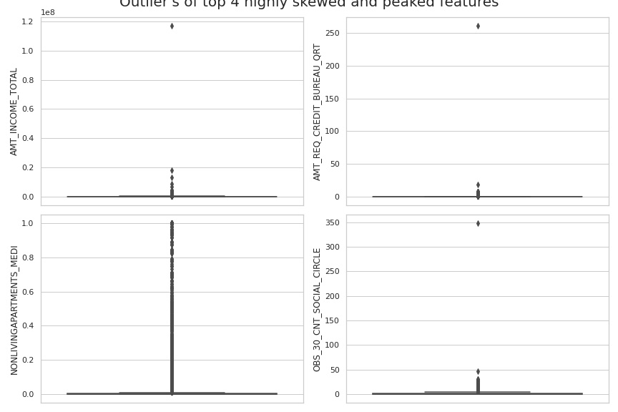
EDA: Application Dataset
Outliers: Randomly selected features
There are extremely large number of outliers, needs attention during Wrangling.

Slide 15
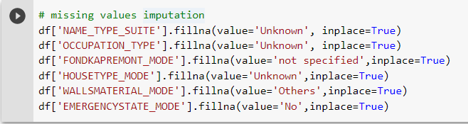
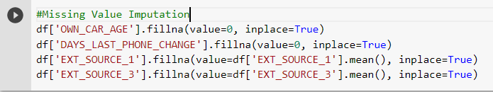
Data Wrangling and Feature Engineering
Handling of Missing Values
Missing values were imputed by exploring each feature in detail.
Categorical Features
‘Name_Type_Suite’, ‘Occupation_type’, ‘Housetype_mode’ were imputed by ‘Unknown’
Some features have pre unidentified clients, those missing values were imputed by the corresponding values such as: the missing values of ‘fondkappermont _mode’ was imputed as ‘not specified’
Some features are imputed by the most frequent value.
Numerical Features
Missing value of the numerical features were imputed by mean and zero based on their distribution and nature.
‘Own_Car_Age’ ,‘Amt_Req_Credit_Bureau’ ,‘Days_Last_Phone_ Change’ was imputed by Zero.
normalized information of the building where the applicant lives such as the average, median and mode of the various features, External sources_1,2,3 are imputed by mean.

Slide 16
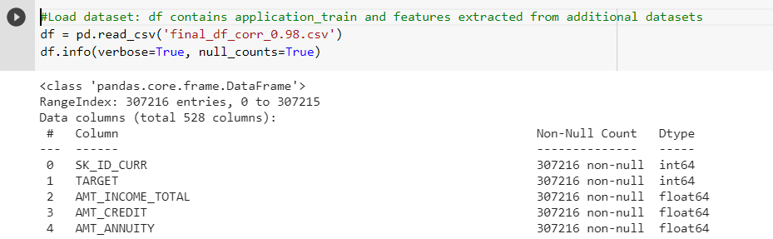
Data Wrangling and Feature Engineering
Feature Engineering
Some of the numerical features of application dataset such as the no. of children, ‘CNT_CHILDREN’, no. of family members, ‘CNT_FAMILY’ are masked by the optimum highest number, for children >7 and for family members >10, were grouped together and finally the features were converted into categorical features.
Additional Datasets:
For categorical features; count of each category and mode.
For numerical features; aggregate values (mean, median, maximum, minimum, sum, standard deviation and variance).
Finally, all the categorical features were replaced by the dummy variables and the highly collinear (corr >98) features were removed.
The final data frame consisted of 528 features and 307216 entries.

Slide 17
Modelling
Modelling Overview
Type: Supervised Learning
Model Evaluation Metrices:
ROC_AUC as a primary model performance parameter keeping the reasonable score for precision and recall for both classes.
The dataset was divided into train and test set (80/20), algorithm was trained into train data and the performance was tested on test data.
Baseline Model:
A slightly higher performing model than ideal baseline, Logistic regression model trained on application dataset as a baseline model.
Algorithms used:
Logistic Regression/Regularized LR
Decision Tree/Random Forest
AdaBoost/XgBoost/Light GBM
Hyperparameter Tuning:
GridsearchCV/RandomsearchCV
Class imbalance:
Resampling by SMOTE and implemented Weighted Model; Weighted model performed better than SMOTE
Feature Selection:
Feature importance /RFECV

Slide 18
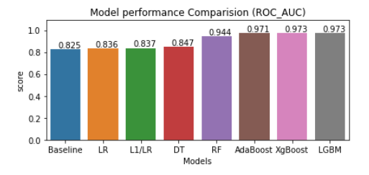
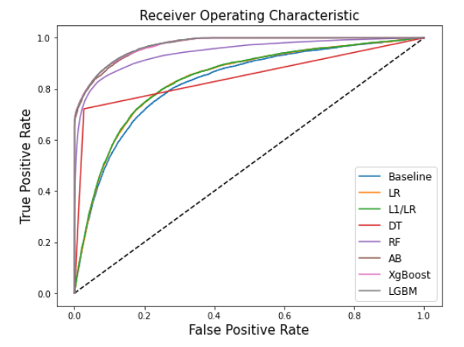
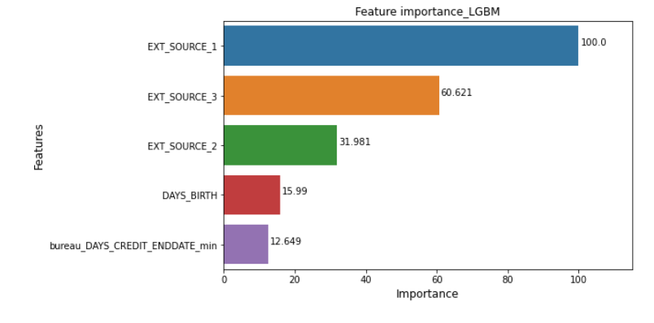
Model comparisions
Preliminary Model Performance
External sources are suspicious; possibility of target leakage. Hence, I decided to exclude these external sources.

Slide 19
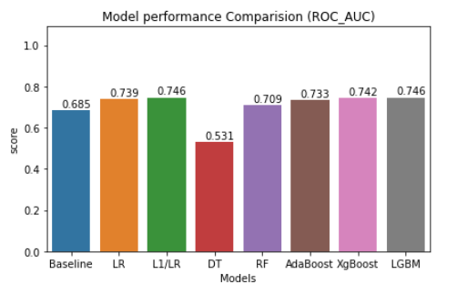
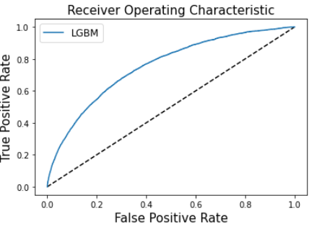
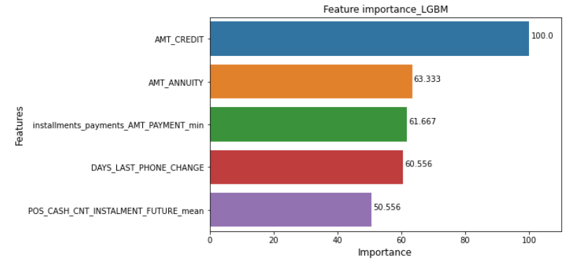
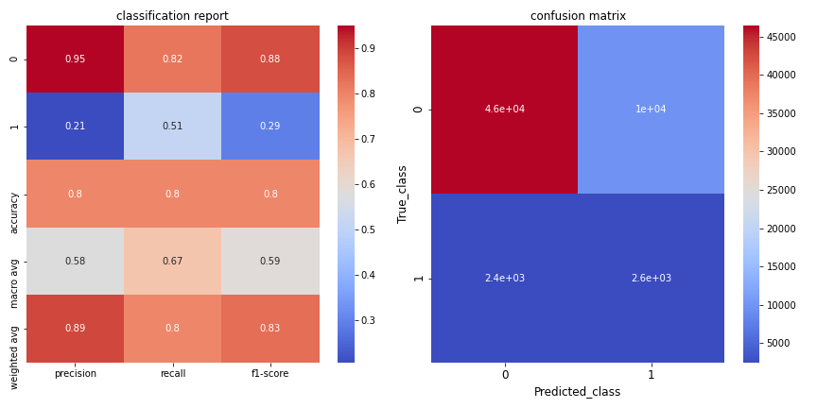
Final Model
Model Performance
Best Model after hyperparameter tuning: LGBM
L1 regularized LR and LGBM performed better.
ROC_AUC=0.754
Most important features:
Classification Report and Confusion Matrix

Slide 20
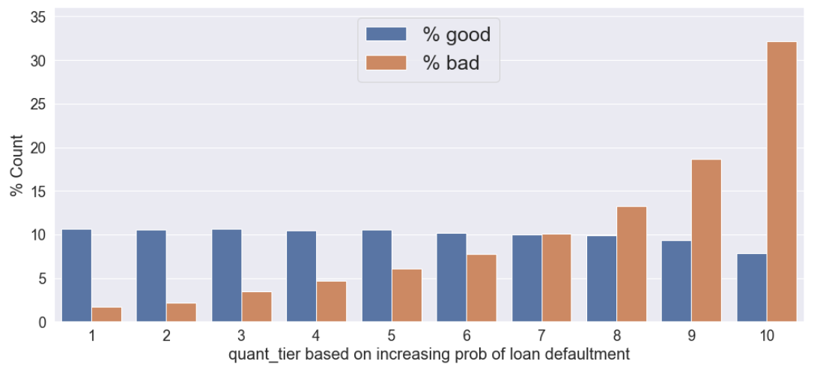
Model Usage: Possible Recommendation
33%
18%
14%
11%
11%
10%
11%
10%
10%
10%
10%
10%
9%
7%
8%
5%
6%
4%
2%
2%
Summary:
33% of bad accounts getting captured in bottom decile
8% of good accounts being tagged as bad - FPR
52% of bad accounts getting capture in tier 9 and tier 10 with FPR of 17%
Suggested strategy:
Decline customers for tier 10 but incurring opportunity cost or volumes from 8% of the good account
Decline customers from tier 10 and manually verification of accounts in tier 9 - this would effectively block 52% of bad accounts and also leaving opportunity to the 9% in tier 9.

Slide 21
Conclusions
All sources of datasets contributed to the predictive power of the model.
Model performance scores are exceptionally high with three features External Sources 1,2,3; these features are not clearly explained and also contains higher fraction of missing values. Hence, I excluded these features for modelling.
Out of 6 supervised classification models, Light GBM provided the best results, ROC_AUC 0.75.
Top factors that affect the loan repayment ability are: Amount_Credit, Amount_Annuity, Installment payment amount and days phone change.
Based on the business perspective, applicants lying on the last tier can be completely declined and on second tier can be handled manually and all other applicants can be blindly approved.
With more ideas and efforts, model performance can be improved.

Slide 22
Suggested ideas for improvements
Three features: External sources are not known clearly. If these features can be used in the model after careful reviewing the data, the performance of the model will definitely improve.
From additional features I generated a common aggregated data from the numerical features, and count and most repeated value from categorical features, we can work more to generate many more features by combining those aggregated values and also by calculating interaction of the features and also to the higher order interaction. This will be computationally intense; however, the performance will be definitely improved.
Precession and recall of the class can be tuned based on the interest of the organization by tuning the probability threshold (0.5 by default).
Hyperparameter tuning has been done in the personal machine with the limited memory and computation power, the performance can be improved by utilizing cluster computing framework such as Apache Spark to better tune the hyperparameter.

Slide 23
Thank you.

